Slide 1



Day 1 Lesson
K- 5th Grade

Slide 2

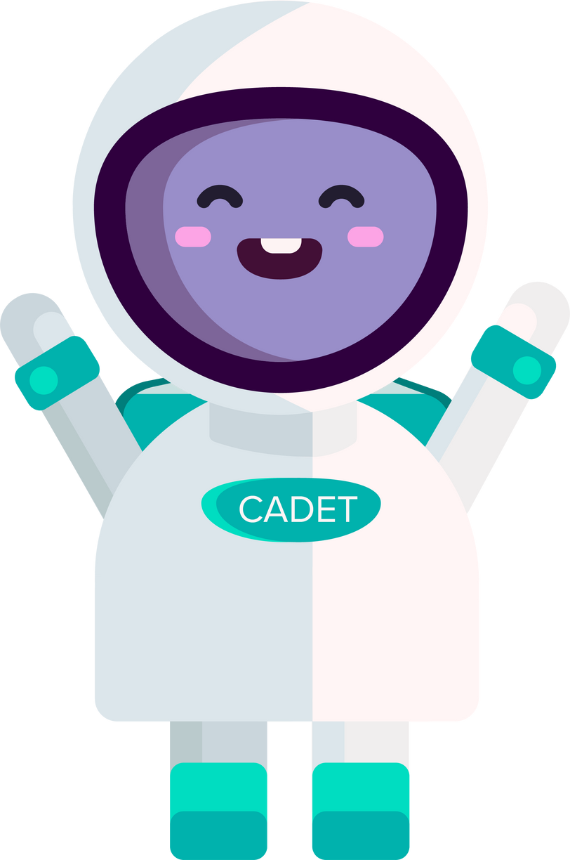
Hi, I'm Cadet! Welcome to Closegap Emotion Training!
I am so
excited to help you learn about your emotions and how you are feeling!

Slide 3
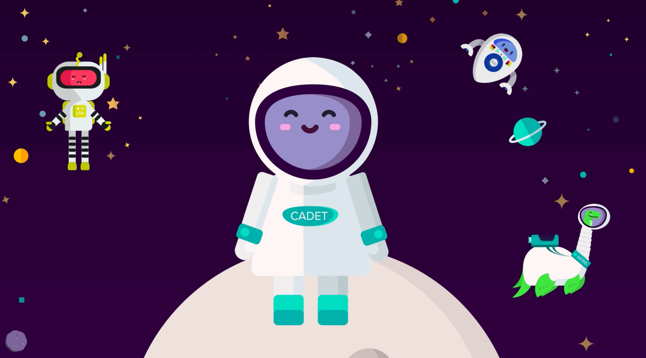


Hello!
I'm Leni!
ILo,
here!
Howdy, I'm Astrid!
Meet my crewmates!

Slide 4
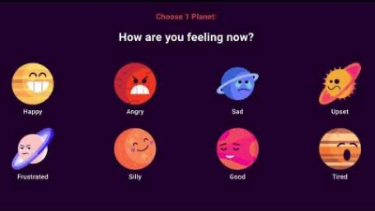
Do's and Don't Video

Slide 5
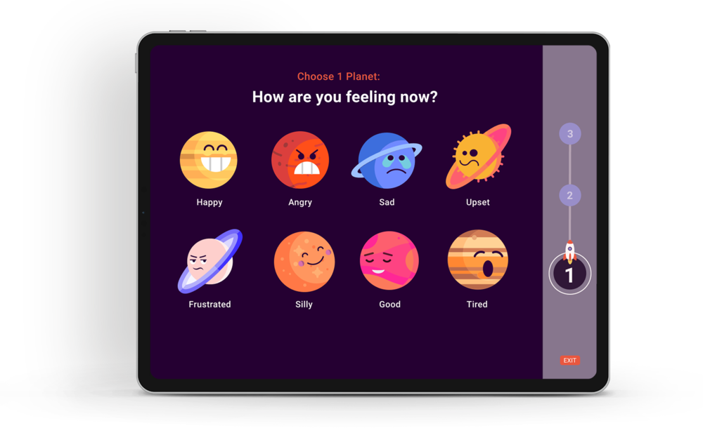
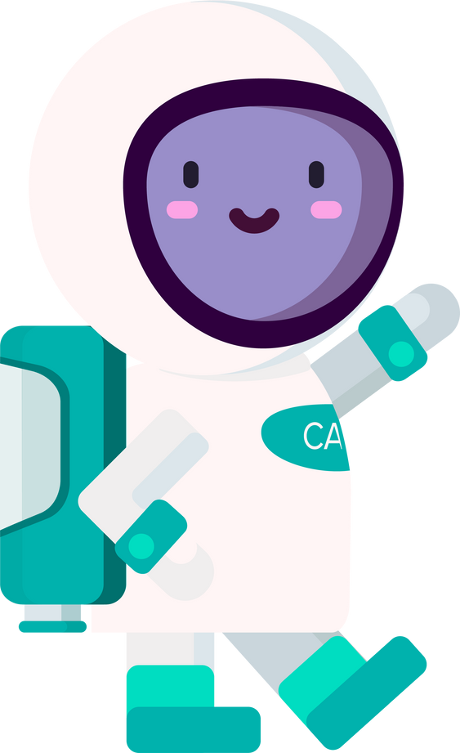
Here are the 8 planets in our emotional solar system! Each planet has its own moons that describe physical feelings.

Slide 6


Happy
  When I see my friends and we laugh together
  Exploring new places and discovering exciting things
  When I achieve something I've been working hard on
Heart Flutters
Energetic
Warm
Light/ Bubbly
Awake
Relaxed

Slide 7
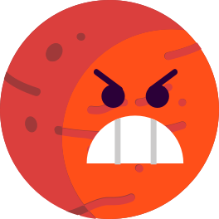
Angry
  When someone takes my favorite toy without asking
  Being unfairly treated or not being listened to
  When things don't go the way I planned or expected
Breathing Hard
Stiff/Tease
Stomach Hurts
Hot/ Red
Head Hurts
Shakey

Slide 8

Sad
  When I miss someone I love, like a family member or a friend
  If I experience a setback or failure in something I cared about
  When I feel left out or excluded from a group
Tired/ Weak
Head Hurts
Stuck/ Frozen
Disconnected
Empty
Stomach Hurts

Slide 9

Worried
  When I have a big test coming up and I'm not sure if I'm prepared enough
  If I see someone I care about getting hurt or going through a tough time
  When I have to speak or perform in front of a group
Stuck/
Frozen
Breathing
Fast
Hot/
Sweaty
Heavy Chest/
Heart
Sick To My Stomach
Fidgety

Slide 10
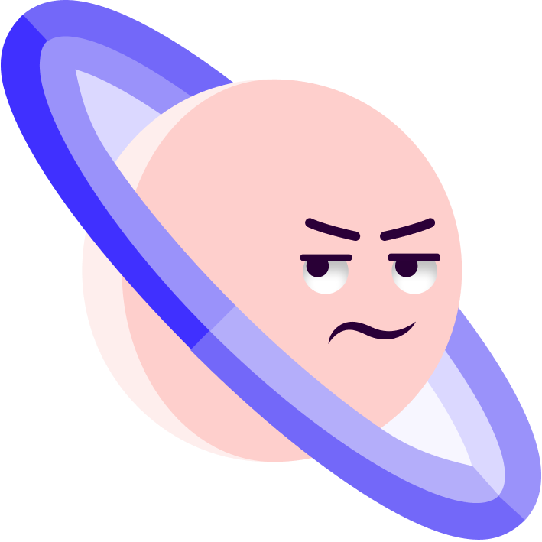
Frustrated
  When I can't figure out a challenging puzzle or problem
  If I keep making the same mistake over and over again
  When I have a hard time expressing myself and people don't understand me
Stuck/
Frozen
Breathing
Hard
Hot/ Red
Shakey
Head Hurts
Stiff/ Tense

Slide 11

Silly
  When I'm with my friends and we start telling jokes and making funny faces
  Dressing up in goofy costumes and acting silly with my siblings or classmates
  When I watch funny videos or cartoons
Comfy/ At Ease
Heart Flutters
Energetic
Warm
Light/ Bubbly
Relaxed

Slide 12

Calm
  Sitting quietly by the window, watching the raindrops fall
  Taking deep breaths and practicing mindfulness
  When I cuddle up with my favorite stuffed animal and listen to soothing music
Breathing Steady
Comfy/
At Ease
Clear/ Awake
Calm
Warm
Relaxed

Slide 13

Tired
  After a long day of playing and exploring
  When I stay up late reading my favorite book or watching a movie
  When I have a busy schedule with school and activities
Nothing/
Numb
Spacey/ Zoned Out
Heavy/ Full
Light/
Empty
Fuzzy/ Unclear
Sleepy

Slide 14
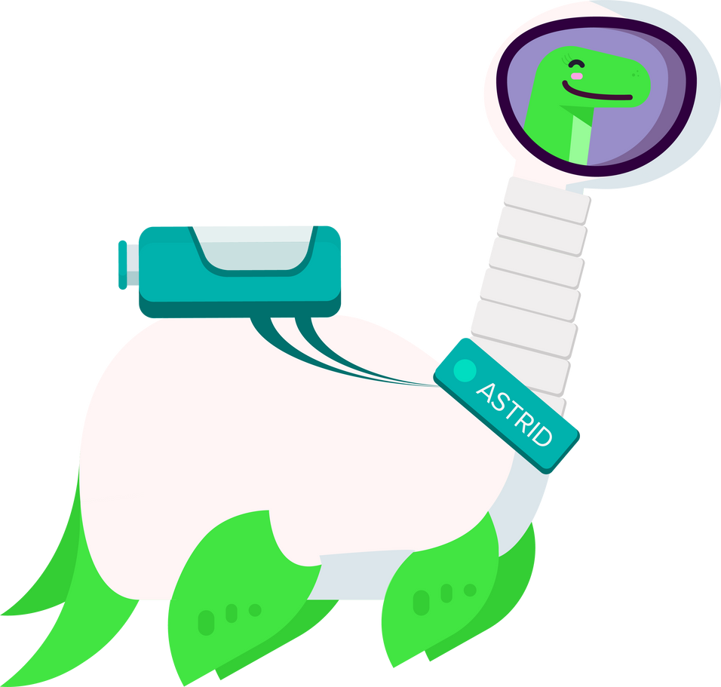
Hello Cadets in training! You're doing great so far. Let's pause and pick a planet that explains how you are feeling right now!

Slide 15
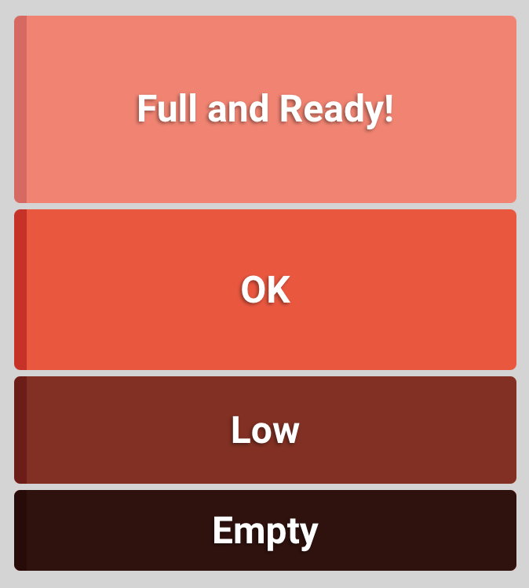
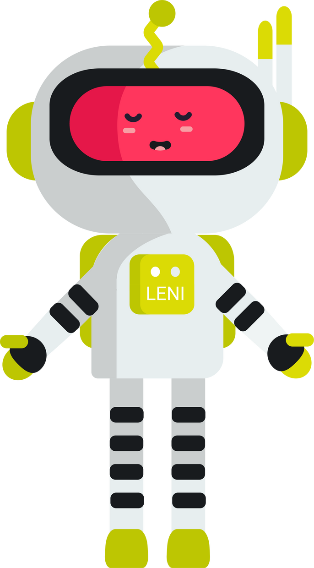

It's important to know how much energy we have! Today, I have low energy. What about you?
How much fuel is in your tank?

Slide 16
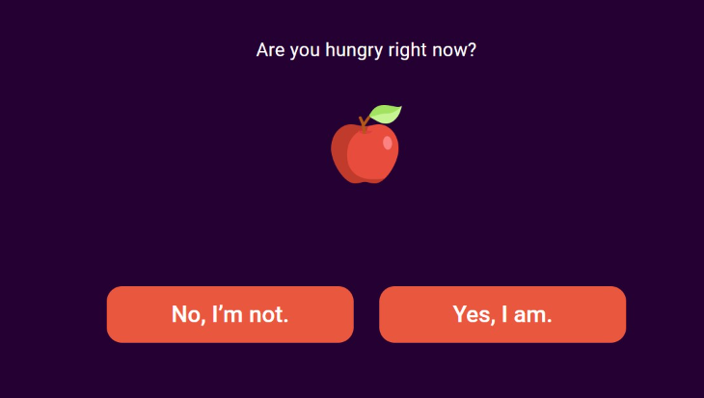
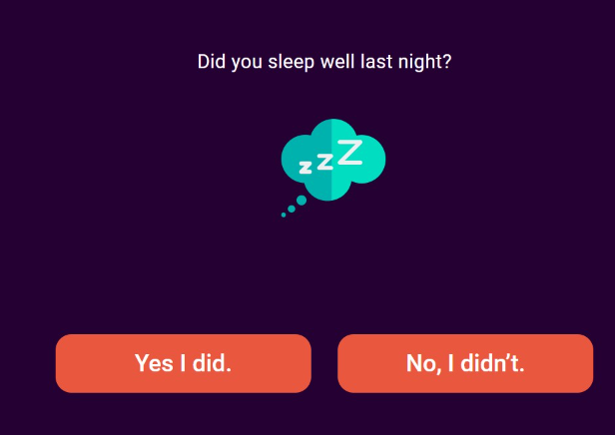
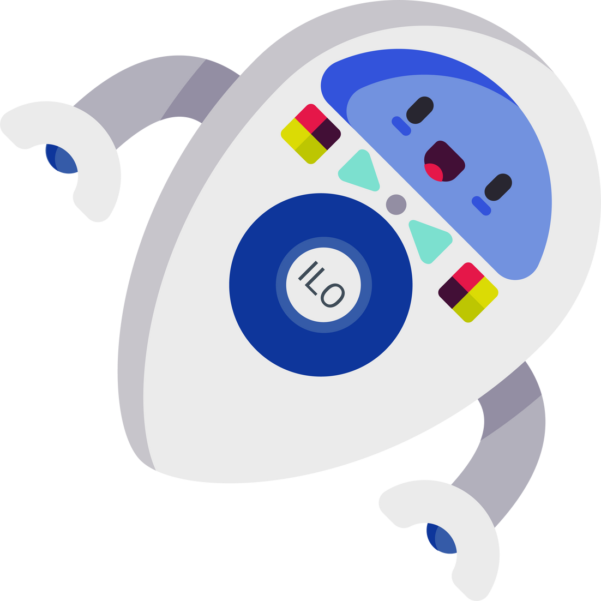
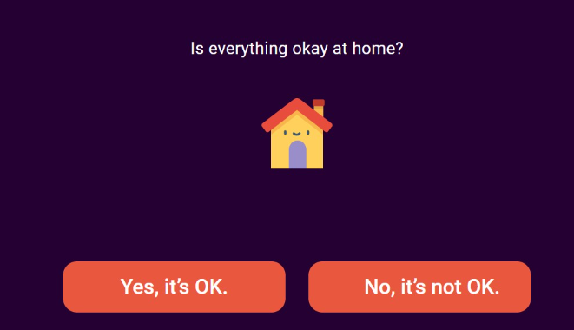
The next part of your check-in is a few questions to see how your teacher can support you.

Slide 17
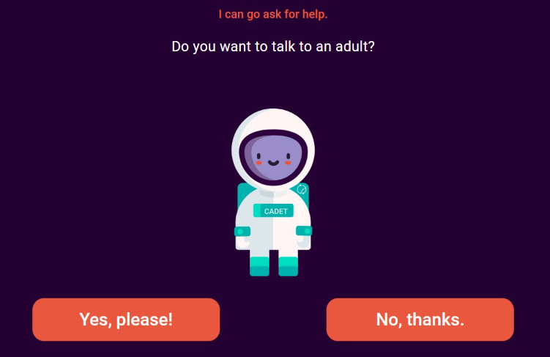
Hey that's me!
Sometimes I'll ask you if you want to talk with an adult. If you want to connect with an adult after your check-in, let me know here!

Slide 18
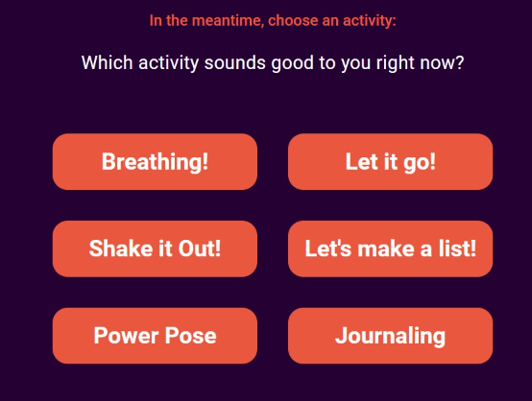

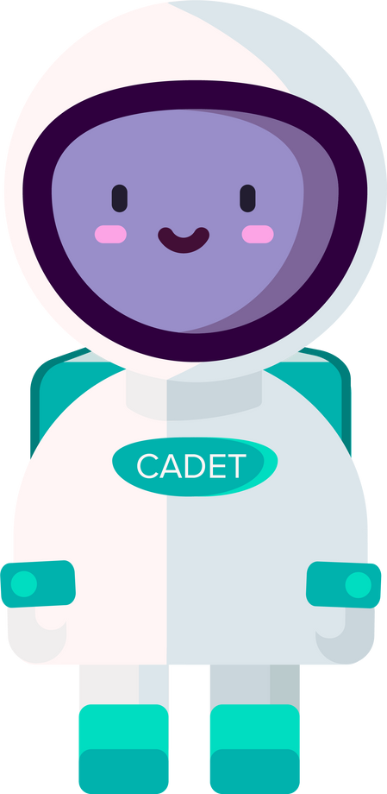
The last part of your check in is my favorite! You get to choose an activity to help prepare you for the rest of the day! Over time you can explore all the different options.

Slide 19

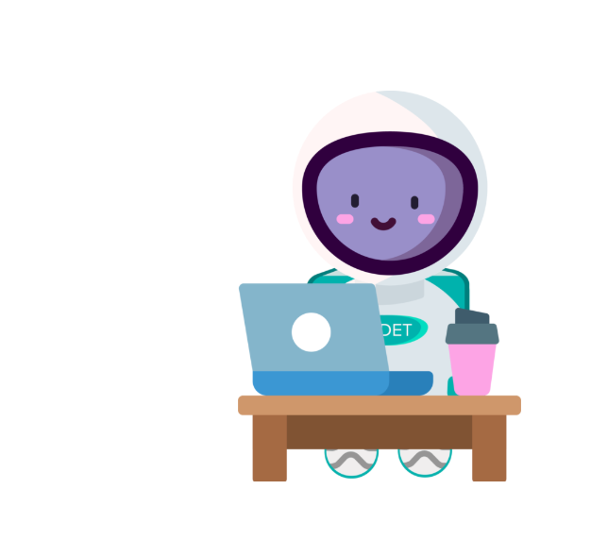

Sometimes there might be a new question or change to your check-in. That's just me making improvements!

Slide 20

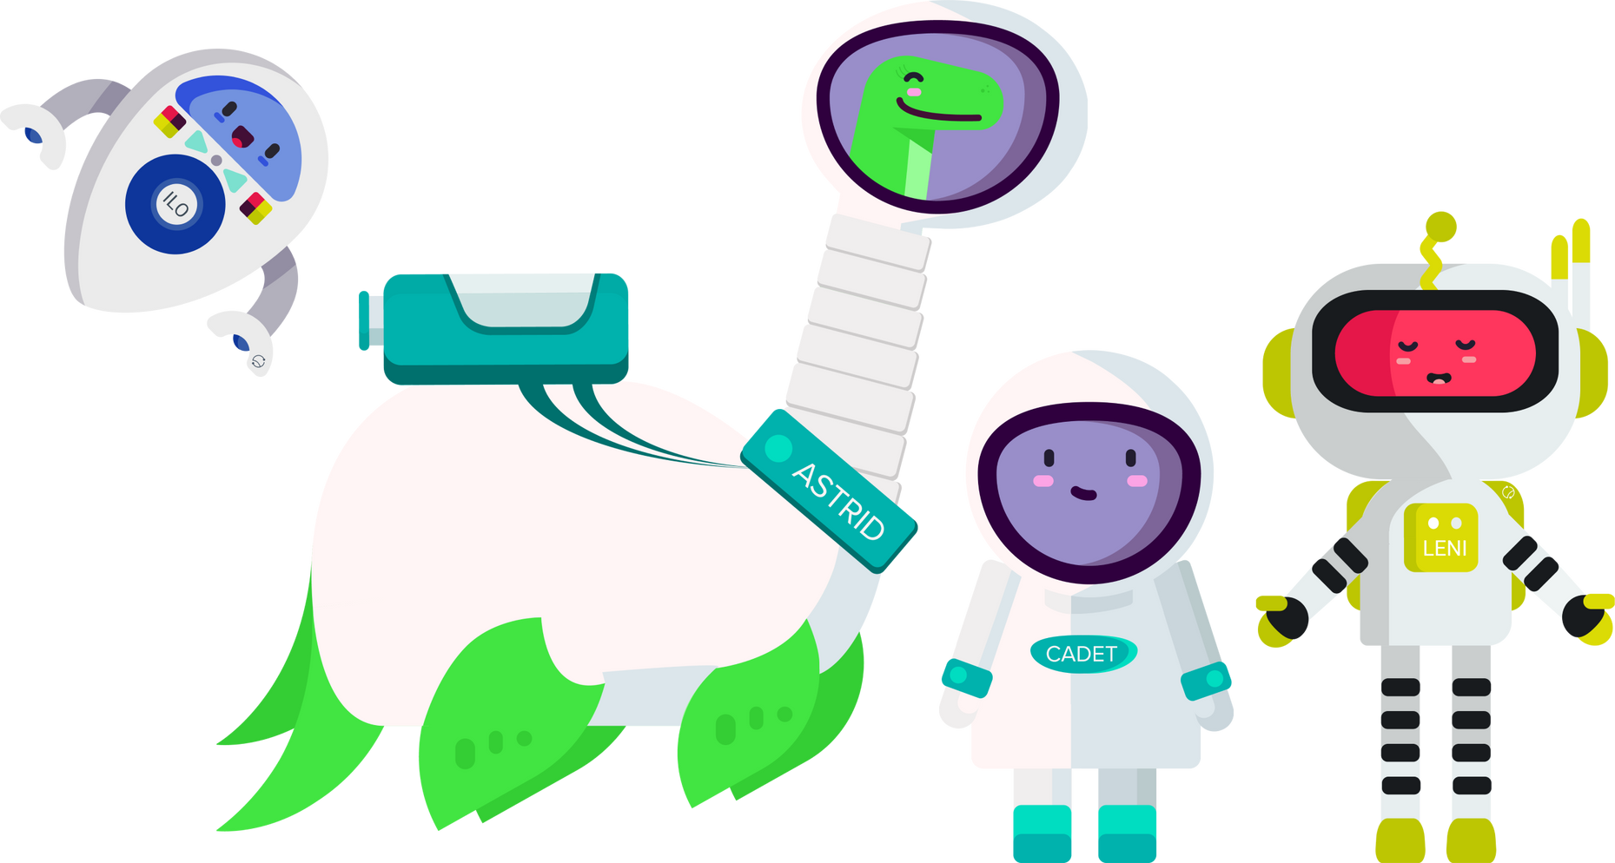
You made it to the end of Closegap Emotional Training! Let's complete our first check-in now!
Congrats!
I'm so proud of you!

Slide 21
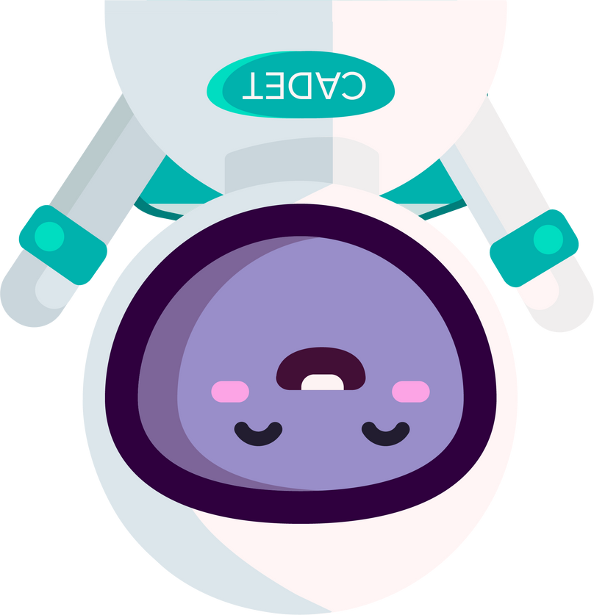

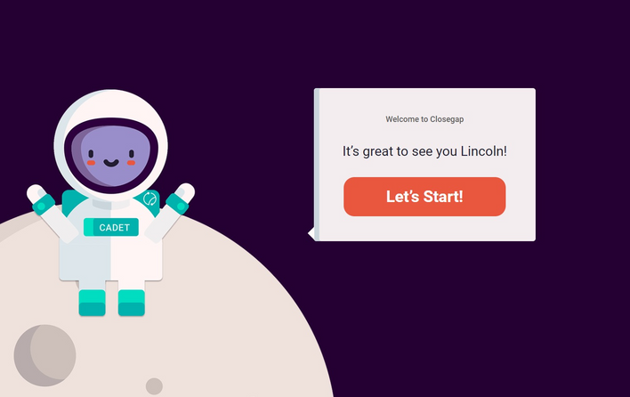


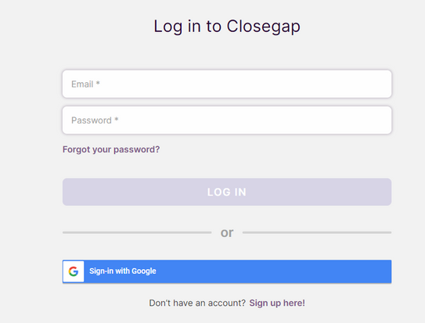
Step 2 : Click "LOGIN"
Step 4 : Complete your check-in with Cadet
Step 1: To go Closegap.org
Step 3 : Sign In

Slide 22

Questions before we take off?

