Slide 1



Day 1 Lesson
6th-12th Grade
1

Slide 2
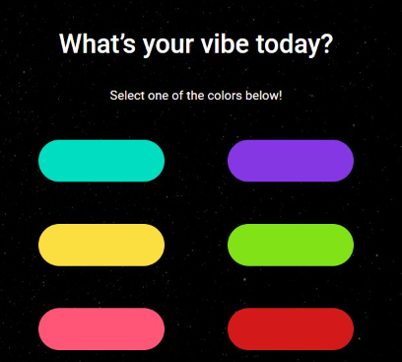
What's your vibe today?
Select a color
Your vibe is the color scheme you want your check-in to be in.

Slide 3
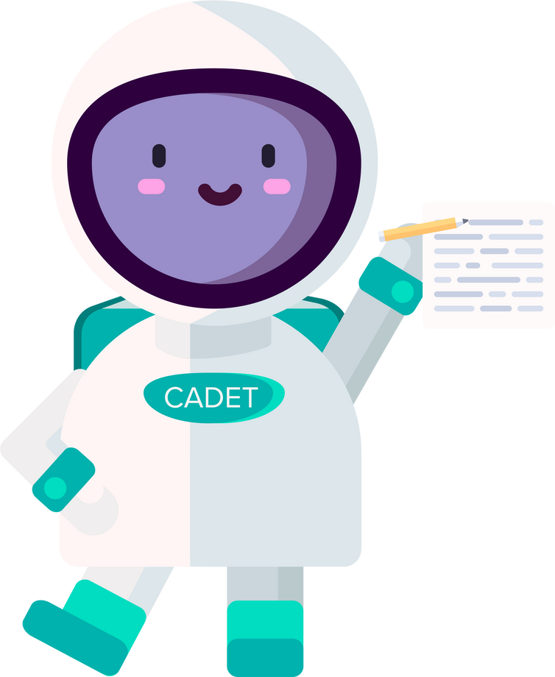
Set a Daily Goal
  I want to do my best at soccer practice.
  I want to ace my math test.
  I want to start working on my social studies project
  I want to be kinder to my little sister.
**You'll be the only one who sees your daily goal!
5

Slide 4
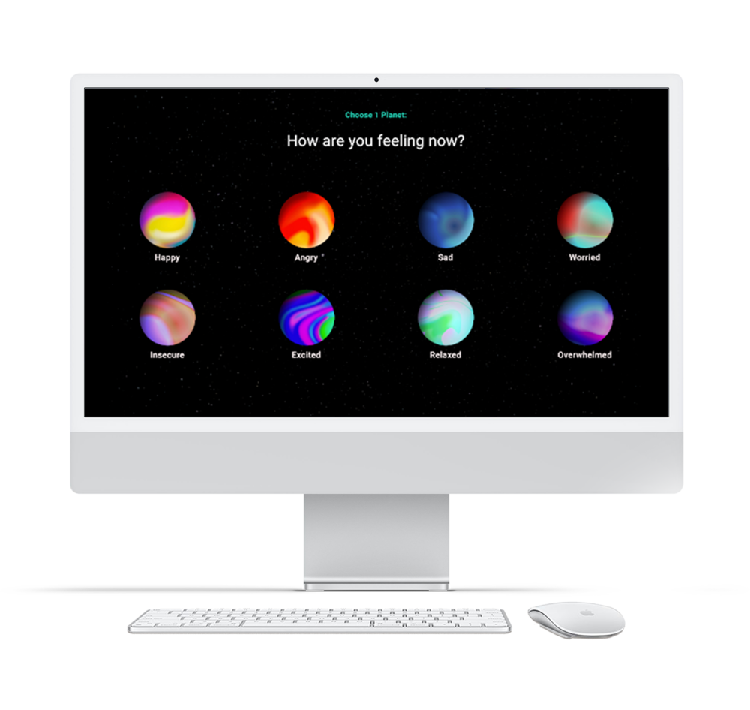
The 8 planets in our emotional solar system
Each planet has its own moons that connect to your physical feelings.

Slide 5
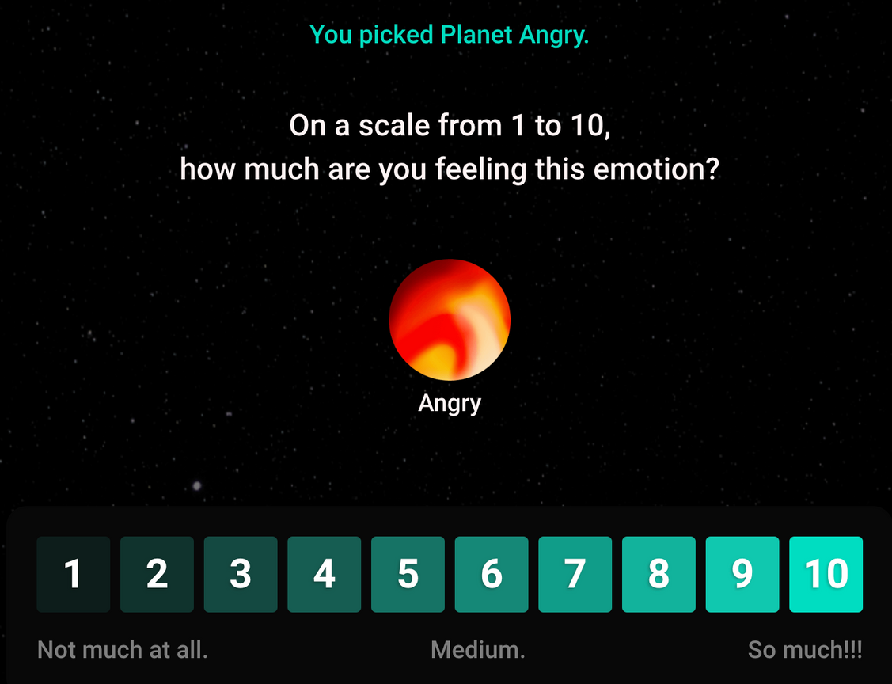
Intensity Scale
How much are you feeling this emotion?
5

Slide 6
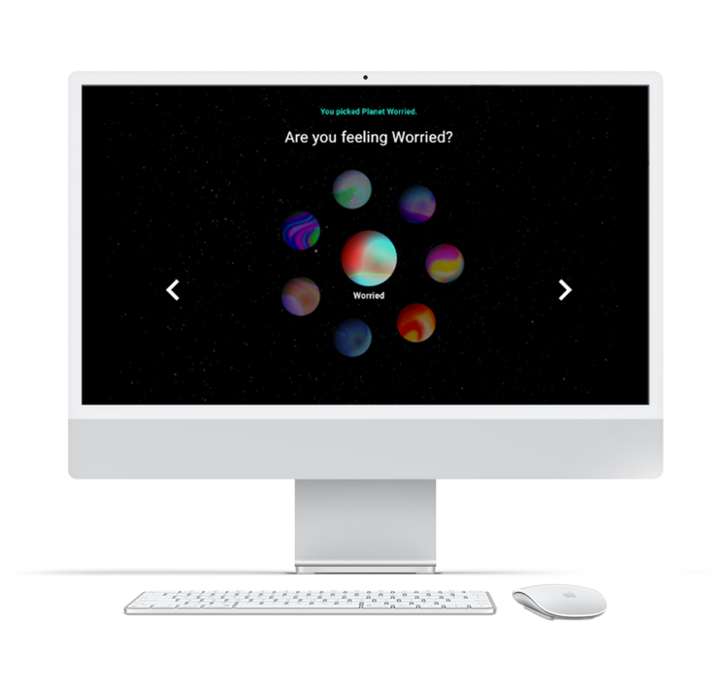
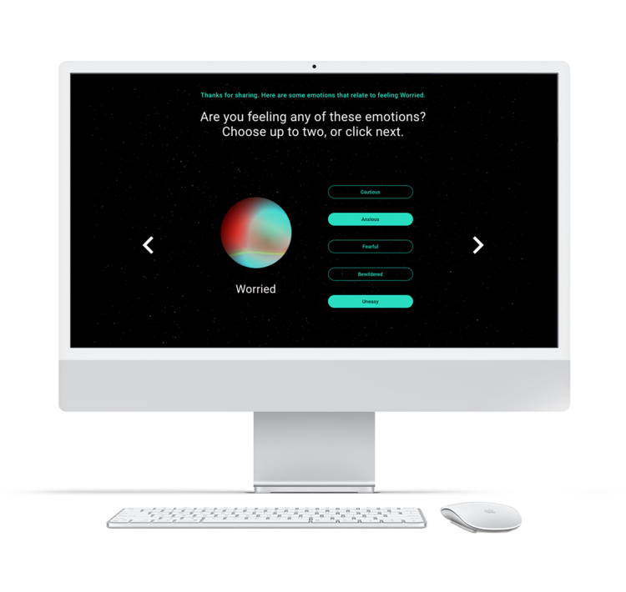
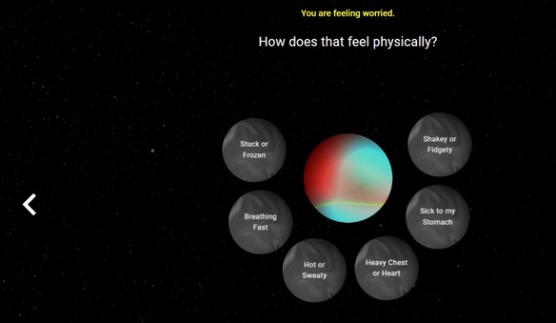
Select a main emotion you're feeling
Select a sub emotion you're feeling
Select how those emotions feel physically

Slide 7


Happy
Overjoyed
Optimistic
Thankful
Proud
Loved
Heart Flutters
Energetic
Warm
Light/ Bubbly
Awake
Relaxed
6

Slide 8

Angry
Defensive
Enraged
Resentful
Frusturated
Annoyed
Breathing Hard
Stiff/Tense
Stomach Hurts
Hot/ Red
Head Hurts
Shakey

Slide 9

Sad
Lonely
Disappointed
Hopeless
Worthless
Disconnected
Disconnected
Tired/ Weak
Empty
Stomach Hurts
Head Hurts
Stuck/ Frozen

Slide 10

Worried
Cautious
Anxious
Fearful
Bewildered
Uneasy
Stuck/
Frozen
Breathing
Fast
Hot/
Sweaty
Heavy Chest/
Heart
Sick To My Stomach
Fidgety

Slide 11

Insecure
Timid
Uncomfortable
Hesitant
Ashamed
Exposed
Shakey/
Fidgety
Heart Racing
Breathing Fast
Heavy Chest/ Heart
Stuck/
Frozen
Disconnected

Slide 12

Excited
Ecstatic
Amazed
Joyful
Inspired
Passionate
Heart Flutters
Energetic
Warm
Light/ Bubbly
Awake
Relaxed

Slide 13

Relaxed
Calm
Pleased
Trusting
Comfortable
Satisfied
Calm
Breathing
Steady/ Strong
Comfy/
At Ease
Clear/ Awake
Warm
Relaxed

Slide 14

Overwhelmed
Panicked
Powerless
Vulnerable
Restless
Stressed
Mind Full of Thoughts
Shakey/ Fidgety
Fast Breathing
Sick to my Stomach
Stuck/ Frozen
Foggy

Slide 15
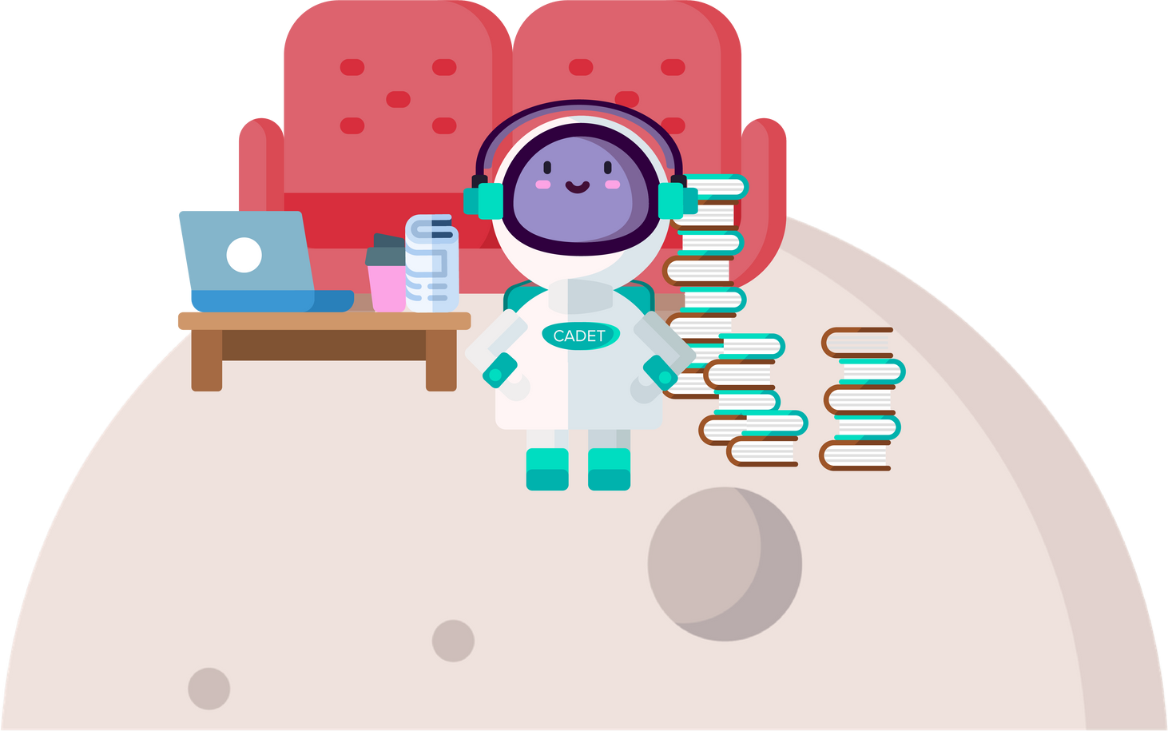
Let's pause. How are you feeling?

Slide 16
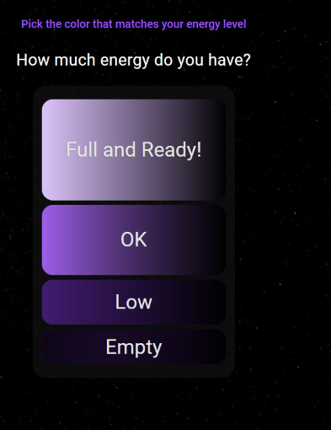

How much fuel is in your tank?
Check in on your energy level.

Slide 17
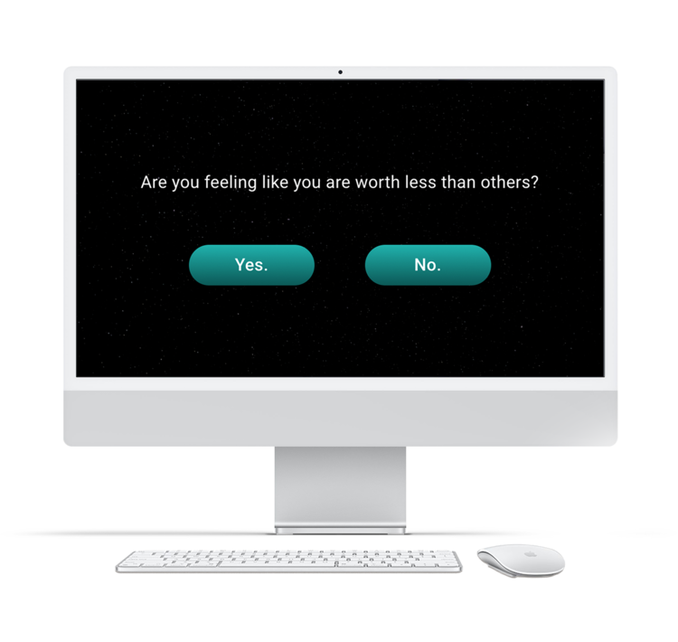
Next, the check-in may ask you a couple questions to see how your teachers can support you.

Slide 18
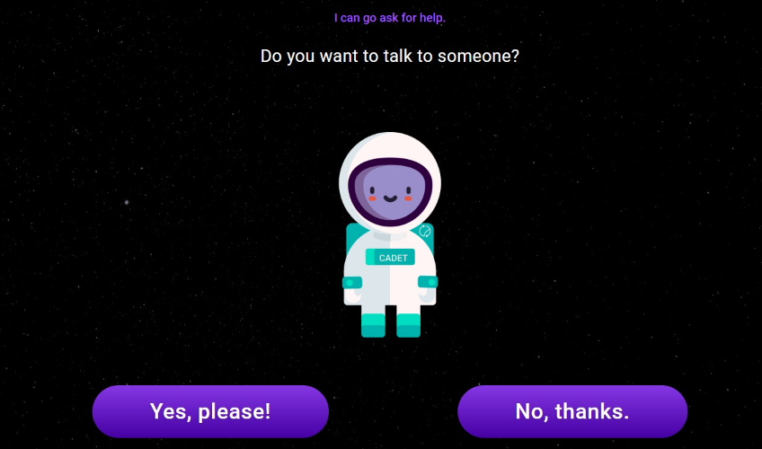
You'll have the option to request to speak with an adult.
This is a new, direct line to school staff.
17

Slide 19
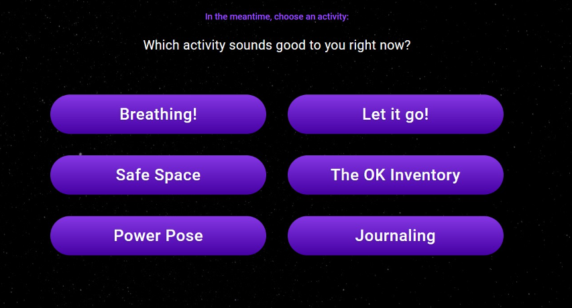
At the end, choose from a series of activities.
18

Slide 20
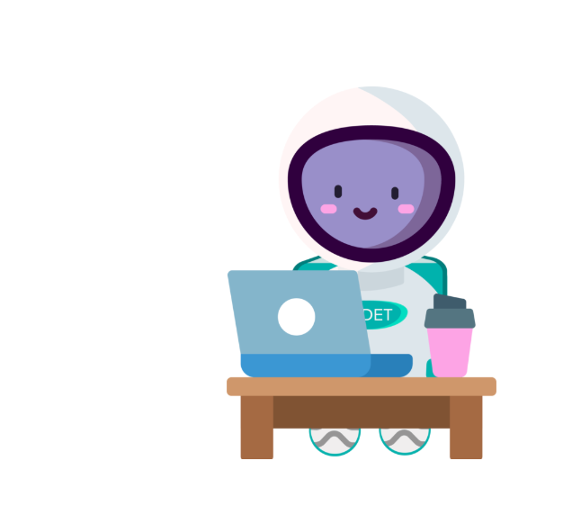

We're often making improvements to the check-in.

Slide 21
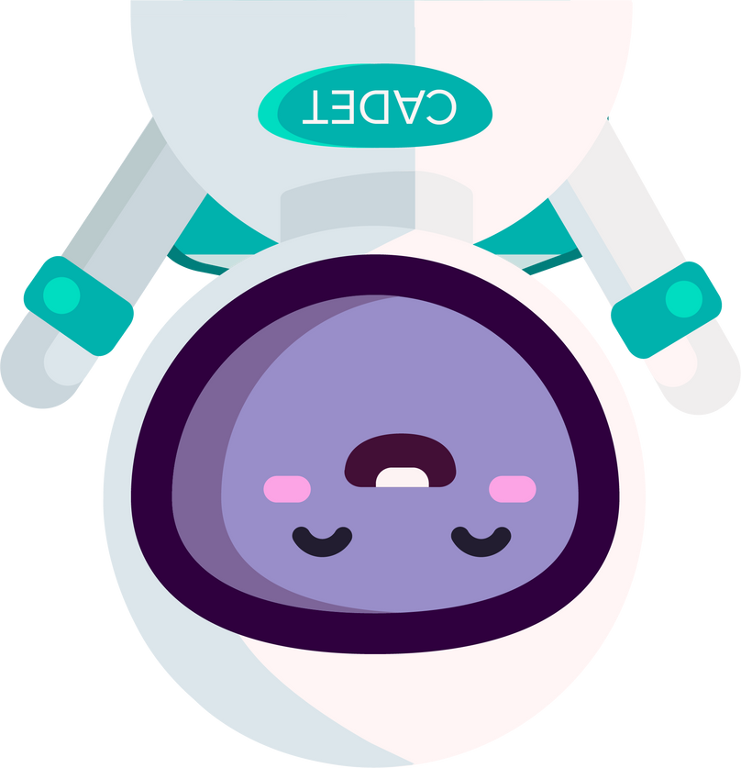

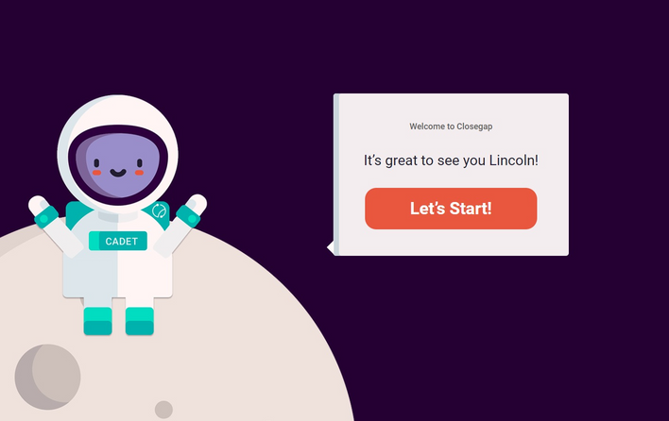


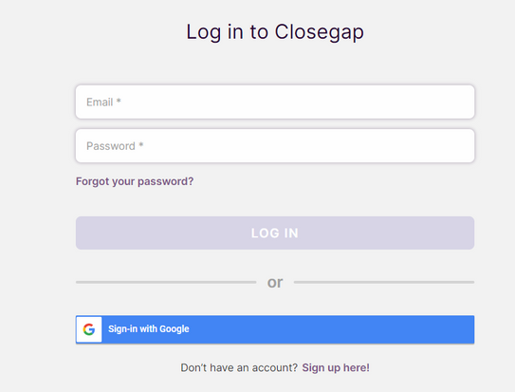
Step 2 : Click "LOGIN"
Step 4 : Complete your check-in with Cadet
Step 1: To go Closegap.org
Step 3 : Sign In

Slide 22
Questions?

